Slide 1
Flight Price Prediction
Submitted by – ULLAS K C

Slide 2
Project Information
Anyone who has booked a flight ticket knows how unexpectedly the prices vary. The cheapest available ticket on a given flight gets more and less expensive over time. This usually happens as an attempt to maximize revenue based on -
1. Time of purchase patterns (making sure last-minute purchases are expensive)
2. Keeping the flight as full as they want it (raising prices on a flight which is filling up in order to reduce sales and hold back inventory for those expensive last-minute expensive purchases)

Slide 3
Required Libraries
Numpy
Pandas
Sklearn
Matplotlib
Seaborn
Warnings
Regular Expression

Slide 4
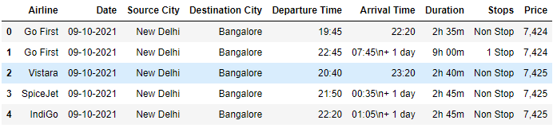
Loading the Dataset

Slide 5
EDA(Exploratory Data Analysis)
There are 9 columns and 2736 rows in the dataset
After doing the feature engineering , there are 11 columns and 2736 rows.
There are null values in this dataset.
Skewness is present in target columns.
Standard deviation is normal in most of the columns.
There is not much difference between mean and 50th percentile, which means data is skewed.
There is not much of difference between 75th percentile and max, which means there are outliers.

Slide 6
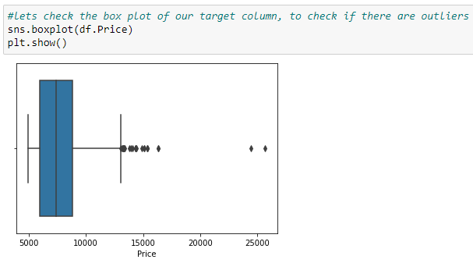
Data Visualization : Outliers in Target Column

Slide 7
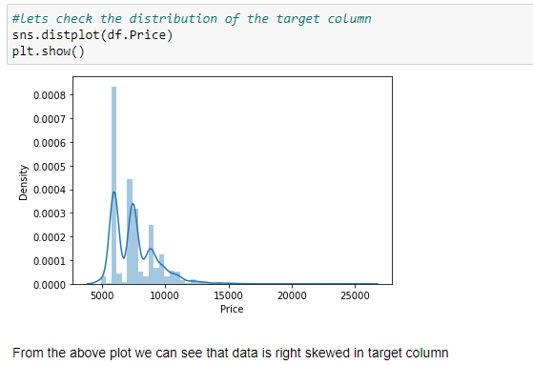
Data Visualization : Distribution of Target Column

Slide 8
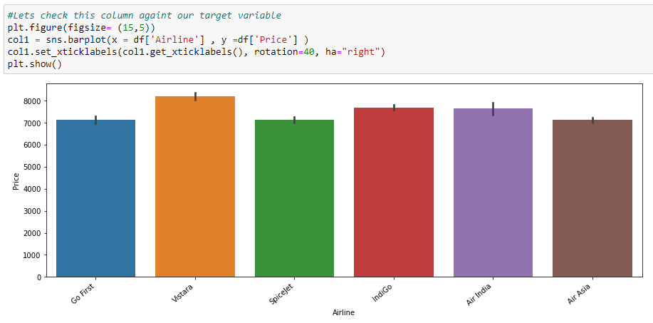
Bivariate Analysis with Target Variable

Slide 9
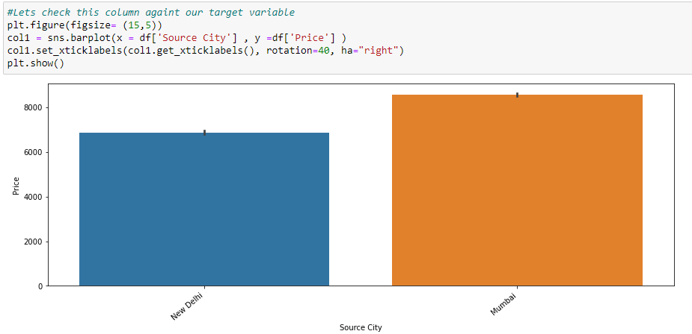
Bivariate Analysis with Target Variable

Slide 10
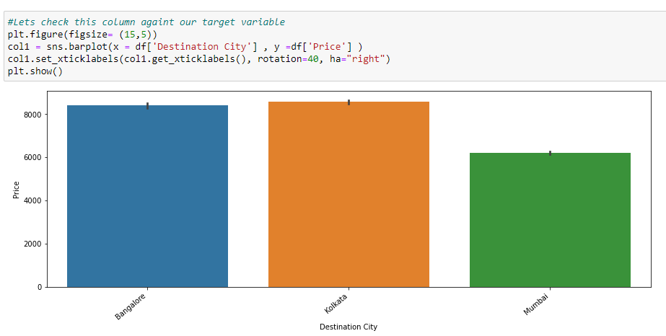
Bivariate Analysis with Target Variable

Slide 11
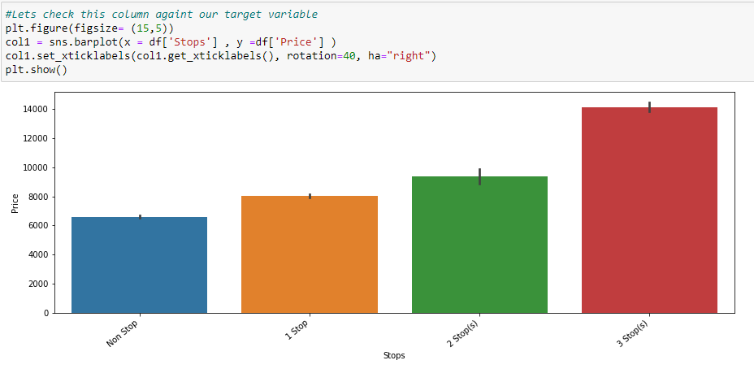
Bivariate Analysis with Target Variable

Slide 12
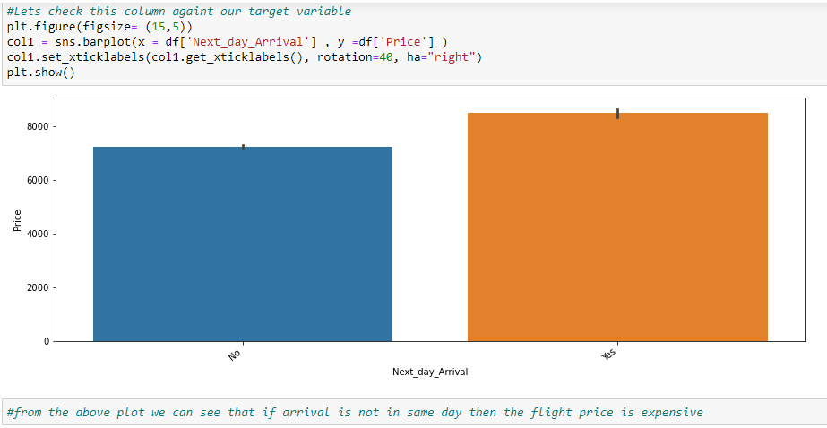
Bivariate Analysis with Target Variable

Slide 13
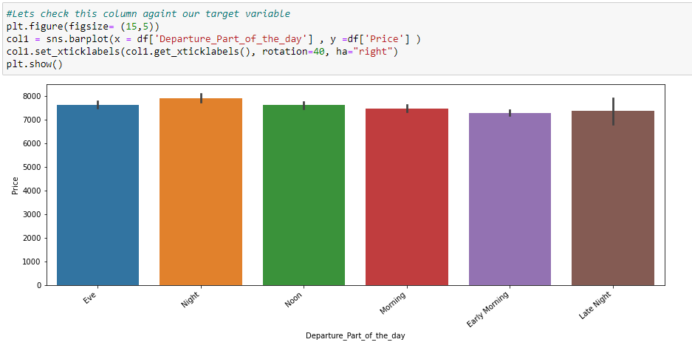
Bivariate Analysis with Target Variable

Slide 14
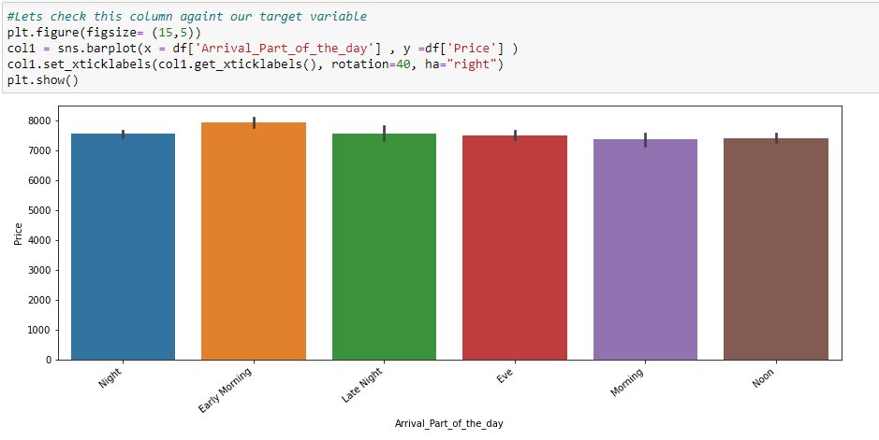
Bivariate Analysis with Target Variable

Slide 15
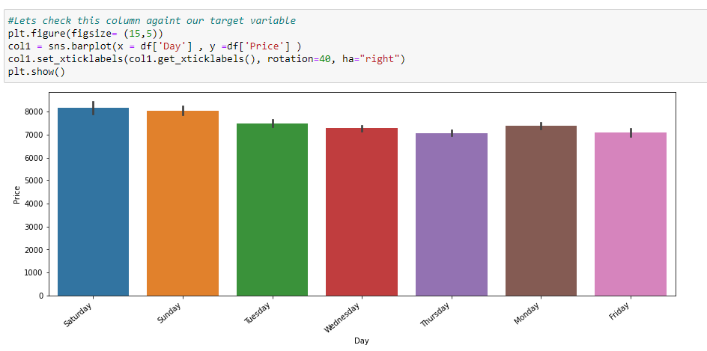
Bivariate Analysis with Target Variable

Slide 16
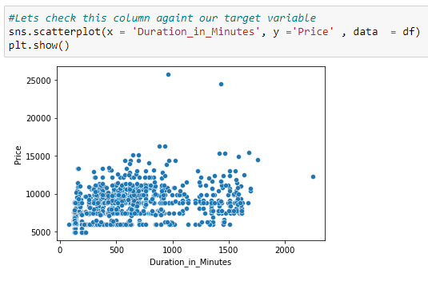
Bivariate Analysis with Target Variable

Slide 17
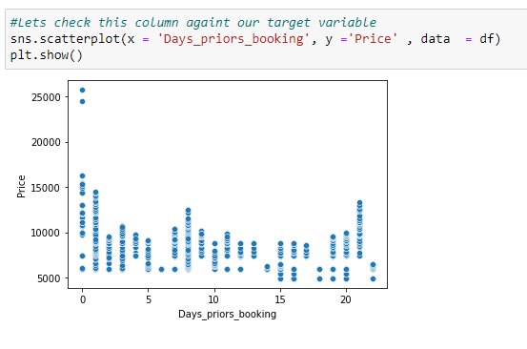
Bivariate Analysis with Target Variable

Slide 18
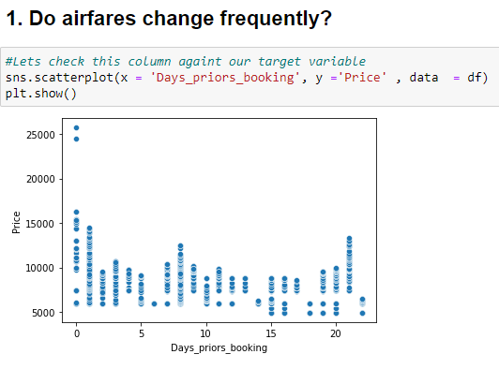
Bivariate Analysis with Target Variable

Slide 19
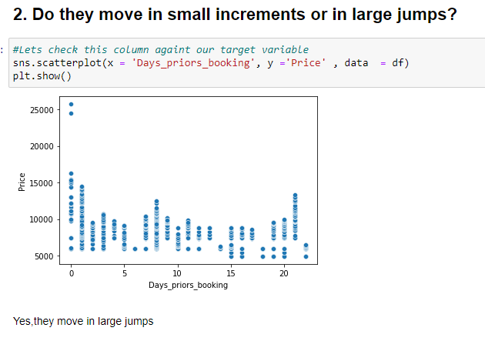
Bivariate Analysis with Target Variable

Slide 20
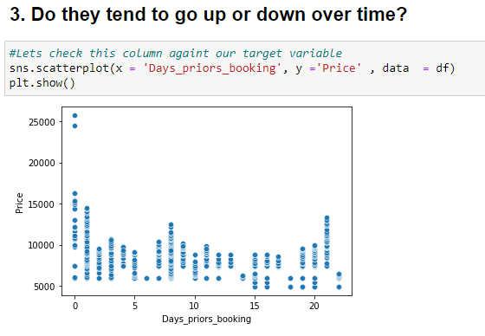
Bivariate Analysis with Target Variable

Slide 21
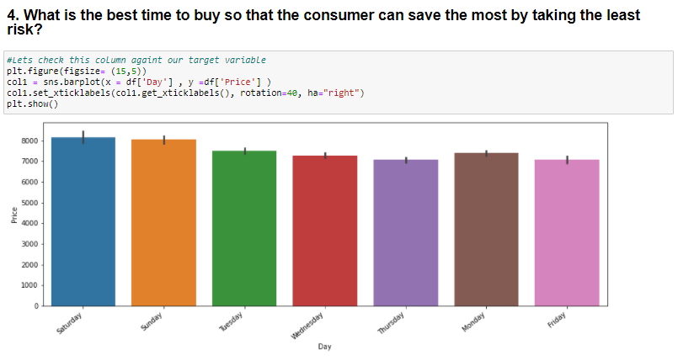
Bivariate Analysis with Target Variable

Slide 22
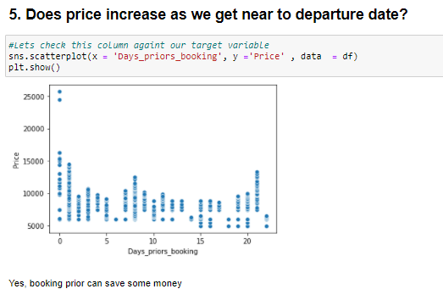
Bivariate Analysis with Target Variable

Slide 23
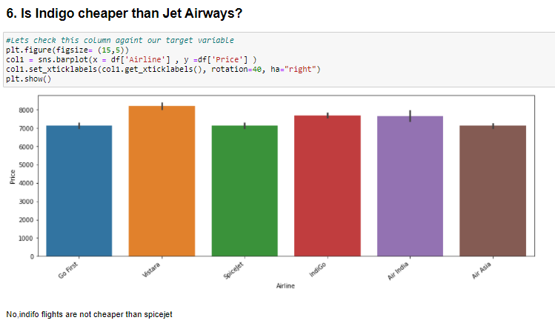
Bivariate Analysis with Target Variable

Slide 24
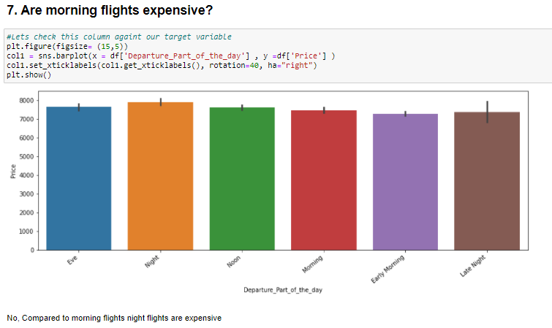
Bivariate Analysis with Target Variable

Slide 25
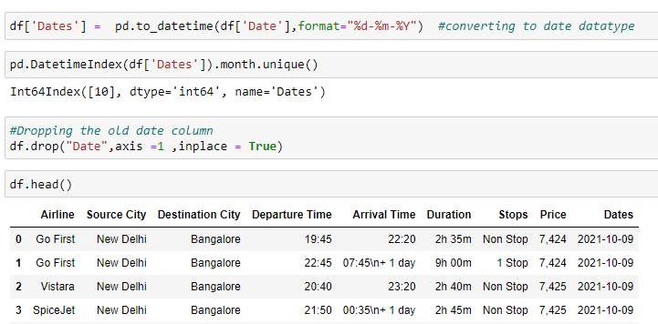
Data Pre-processing : Feature Extraction

Slide 26
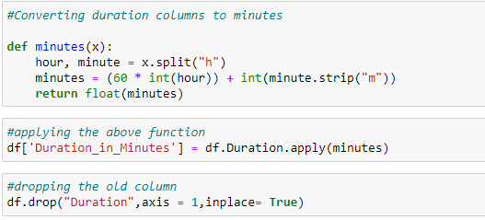
Data Pre-processing : Feature Extraction

Slide 27
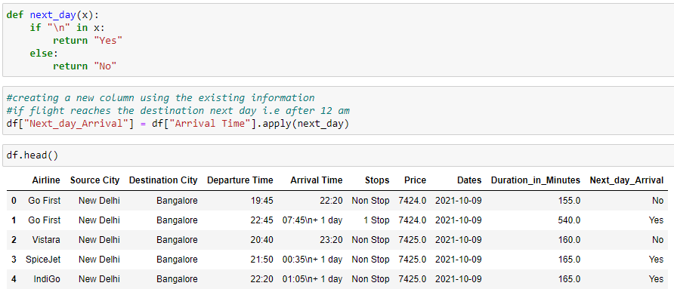
Data Pre-processing : Feature Extraction

Slide 28
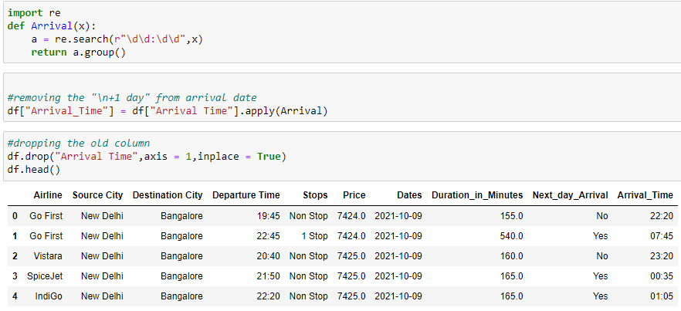
Data Pre-processing : Feature Extraction

Slide 29
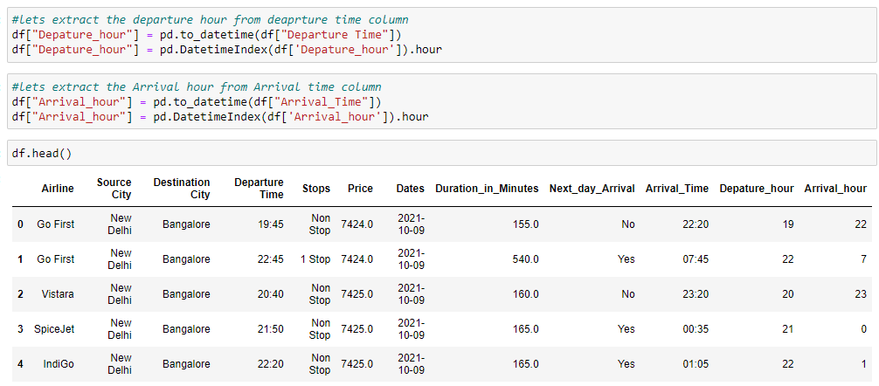
Data Pre-processing : Feature Extraction

Slide 30
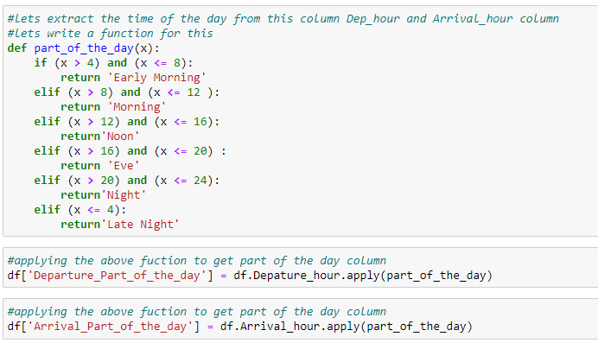
Data Pre-processing : Feature Extraction

Slide 31
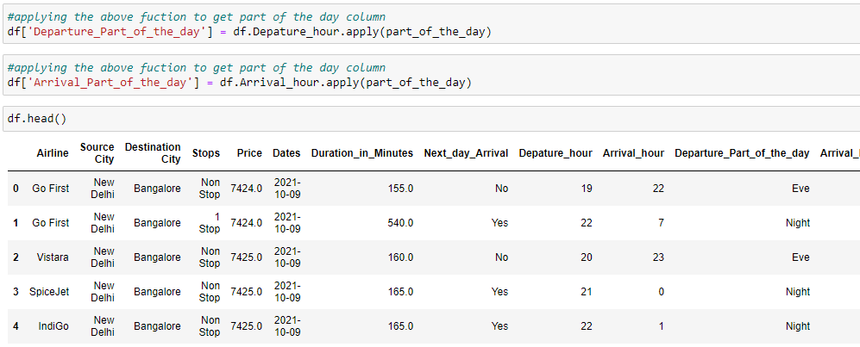
Data Pre-processing : Feature Extraction

Slide 32
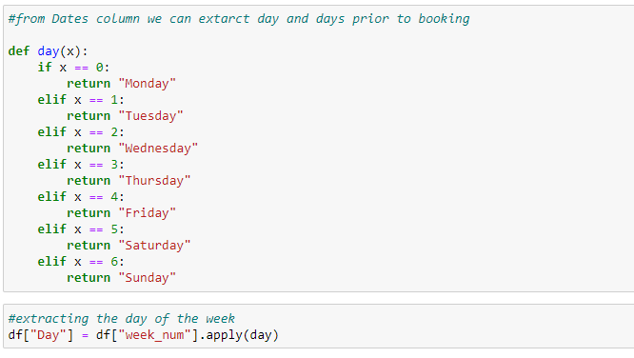
Data Pre-processing : Feature Extraction

Slide 33
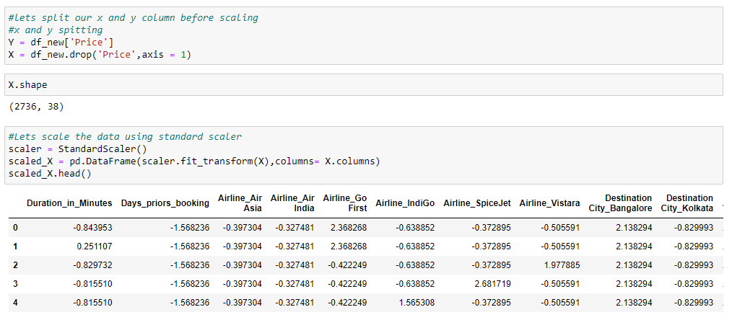
Data Pre-processing :Data Scaling

Slide 34
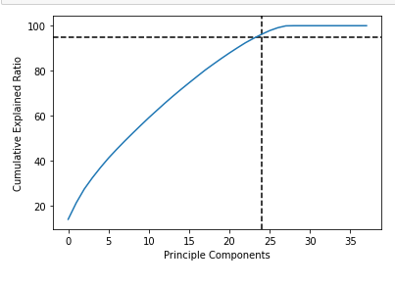
Data Pre-processing :PCA
We used PCA because we have 38 columns in this dataset which is high.
We should always use scaled data for performing the PCA.
We took 95% data which is equivalent to 24 columns.

Slide 35
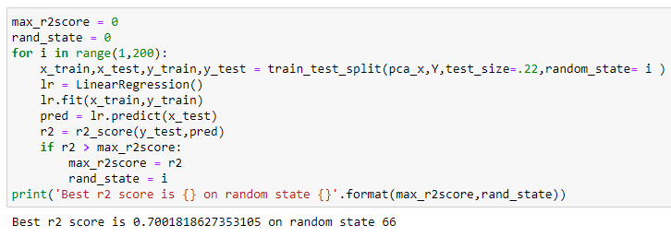
Best Random State

Slide 36
Model Selection
I choose five models to select the best from them.
Decision Tree Regressor
Linear Regression
Random Forest Regressor
AdaBoost Regressor
KNN Regressor

Slide 37
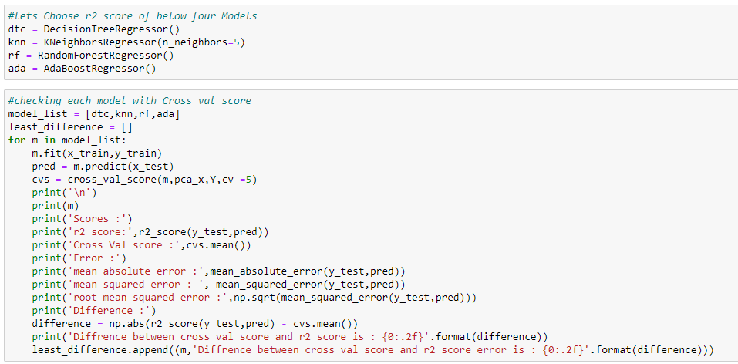
Model Selection : Code

Slide 38
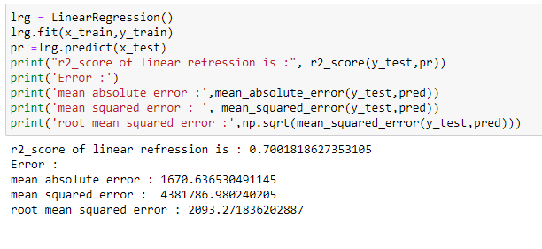
Model Selection : Linear Regression Result

Slide 39
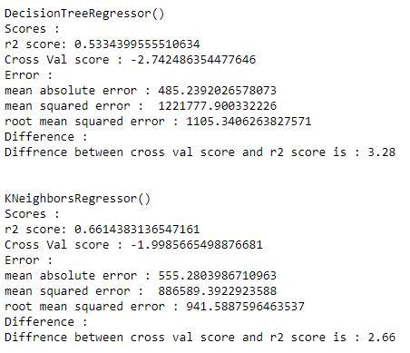
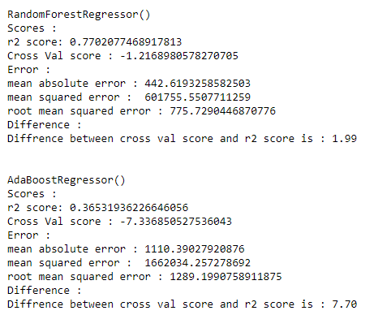
Model Selection : Result

Slide 40
Model Selection
We can see that Linear Regressor is giving the best R2 Score but the model is not overfitted.
We can perform hyper parameter tuning for Linear Regression.

Slide 41
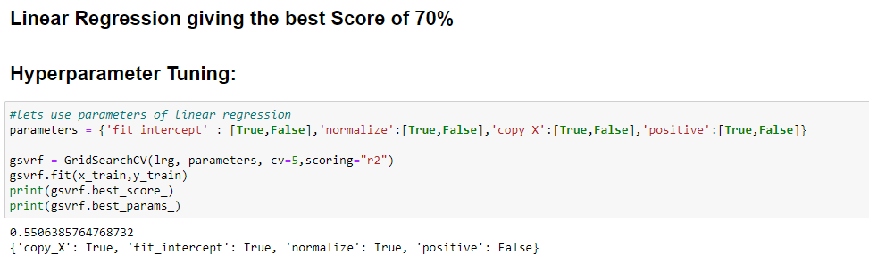
Hyper parameter Tuning :

Slide 42
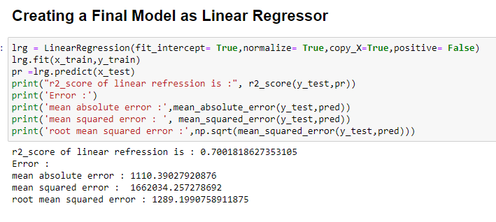
Final Model

Slide 43
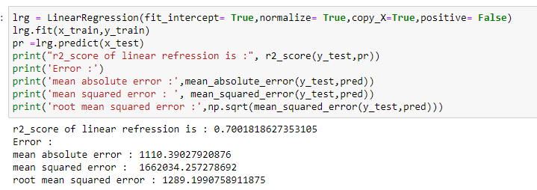
Final Model : Result (Linear Regression)

Slide 44
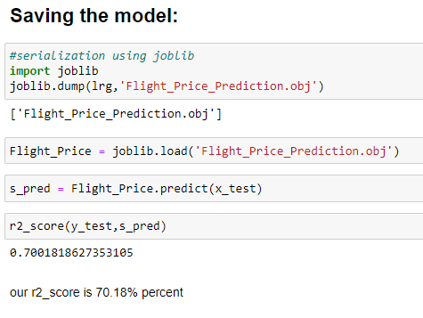
Saving the model:

Slide 45
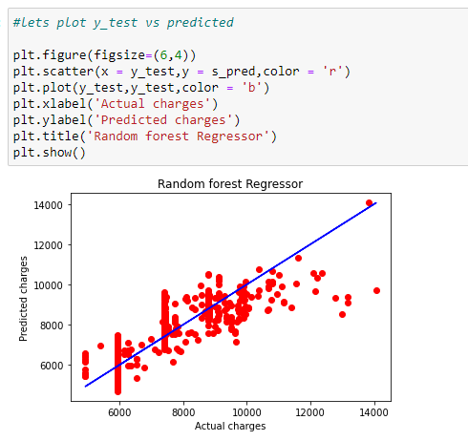
Plotting y_test vs predicted

Slide 46
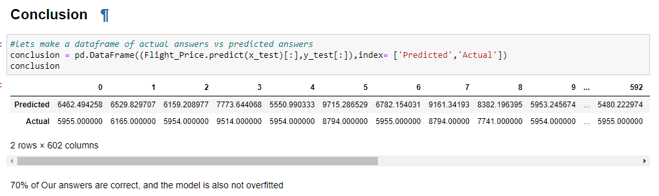
Saving the Results as Dataframe

Slide 47
Conclusion
Though this is the simplest model we’ve built till now, the final predictors still seem to have high correlations. One can go ahead and remove some of these features, though that will affect the adjusted-r2 score significantly (you should try doing that).
Thus, for now, the final model consists of the 11 variables mentioned above
Yes there is still room for improvement, like doing a more
Web scraping from different websites, extensive feature engineering, by comparing and plotting the features against each other and identifying and removing the noisy features. The values of R-squared obtained from the algorithm give the accuracy of the model. In the future, if more data could be scraped such as the business class, so predicted results will be more accurate.

